Slide 1
Enquiry question
Why is the Meeting House a significant place in the history of Claverham?

Slide 2
Enquiry overview
Lesson 1: What does it mean for a place to be significant?
Lesson 2: What places are significant in Claverham?
Lesson 3: Who used the Meeting House in the past and why was it significant to them?
Lesson 4 (visit to the Meeting House): What can the building tell us about the significance of the Meeting House to Claverham?
Lesson 5: How has the significance of the Meeting House changed over time?
Lesson 6 (outcome activity): How can we record and share the history of the Meeting House?

Slide 3
Lesson 1
What does it mean for a place to be significant?

Slide 4
Lesson 1 overview
Introduce ‘mystery building’
What do we mean by significant?
What makes a building significant?
Activity: What buildings are significant to you?
Plenary

Slide 5
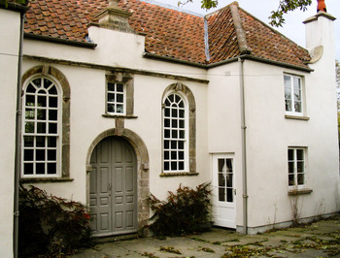
Where is this building?
Notes:
Image: Copyright © 2009, Claverham Meeting House Trust, all rights reserved, from www.claverhammeetinghouse.org.uk (permission to use all images held by the Meeting House Trust given by the Management Trust)

Slide 6
This is Claverham Meeting House.
Have you ever been here or seen it?
Notes:
Image: Copyright © 2009, Claverham Meeting House Trust, all rights reserved, from www.claverhammeetinghouse.org.uk (permission to use all images held by the Meeting House Trust given by the Management Trust)

Slide 7
We will be exploring this building to discover…
Why is the Meeting House a significant building in the history of Claverham?

Slide 8
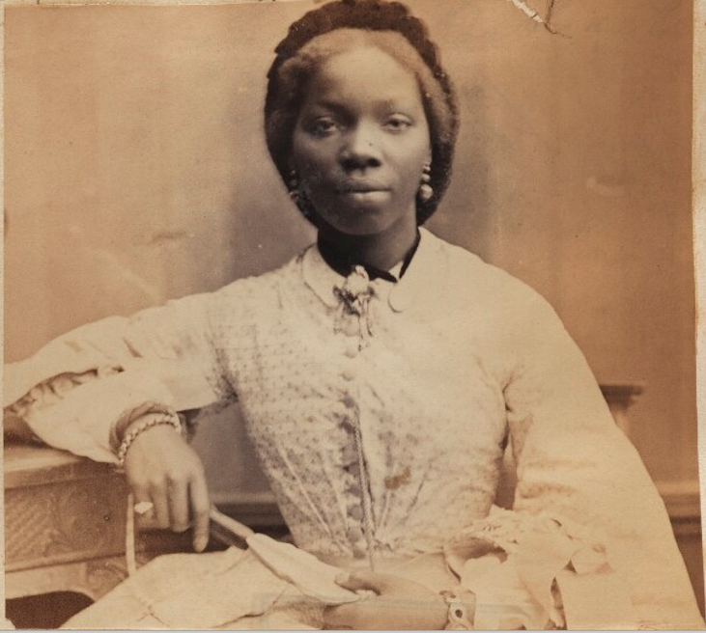
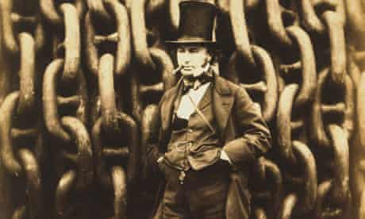
What do we mean by significant?
We have already learnt about some significant people from the past.
Can you remember what makes them significant?
Notes:
Images: © National Portrait Gallery, www.npg.org.uk
Sarah Forbes Bonetta (Sarah Davies) by Camille Silvy, albumen print, 15 September 1862, NPG Ax61384
Isambard Kingdom Brunel by Robert Howlett, albumen print, November 1857, NPG P112

Slide 9
What do we mean by significant?
They are significant because they…
changed events at the time at which they lived
improved lots of people’s lives – or made them worse
changed people’s ideas
had a long-lasting impact on their country or the world
was a really good or a very bad example to other people of how to live or behave
©Ian Dawson
Notes:
Significance criteria: © Ian Dawson

Slide 10
What makes a building significant?
Buildings can also be significant and can tell us about the history of a place.
They are significant because they…
played an important role in people’s lives
were the location for a key event in the past
are a good example of a building from a particular time period
are linked with a significant individual (e.g. their home)
Role Event Example Linked

Slide 11
What places are significant to you?
Does it play an important role in your life?
Has a special event happened there?
Is it a good example of a building for our time?
Is it linked to a significant person?
Role Event Example Linked

Slide 12
Activity 1
Draw and label pictures to show which places or buildings are significant to you.
Challenge: Can you explain why they are significant to you and how they might link with our significance criteria?
Role Event Example Linked

Slide 13
Plenary
Did any of you pick the same place?
Do you think that the places you chose will still be significant to you in 50 years’ time?
Will they be significant to other people in 100 years’ time?

Slide 14
Enquiry question
Why is the Meeting House a significant place in the history of Claverham?

Slide 15
Enquiry overview
Lesson 1: What does it mean for a place to be significant?
Lesson 2: What places are significant in Claverham?
Lesson 3: Who used the Meeting House in the past and why was it significant to them?
Lesson 4 (visit to the Meeting House): What can the building tell us about the significance of the Meeting House to Claverham?
Lesson 5: How has the significance of the Meeting House changed over time?
Lesson 6 (outcome activity): How can we record and share the history of the Meeting House?

Slide 16
Lesson 2
What places are significant in Claverham?

Slide 17
Lesson 2 overview
Activity 1: Exploring local map
Exploring our historic environment
What is a listed building?
Activity 2: Making comparisons with historic maps
Plenary

Slide 18
Activity 2
Explore the historic map and see whether you can see all the same buildings.
What changes do you notice on the historic map compared to now?
Have any key features stayed the same?
Challenge: What do these changes tell us about Claverham in the past compared with the Claverham that we know?
Notes:
Side-by-side comparison map available at: https://maps.nls.uk/geo/explore/side-by-side, accessed 26 May 2022

Slide 19
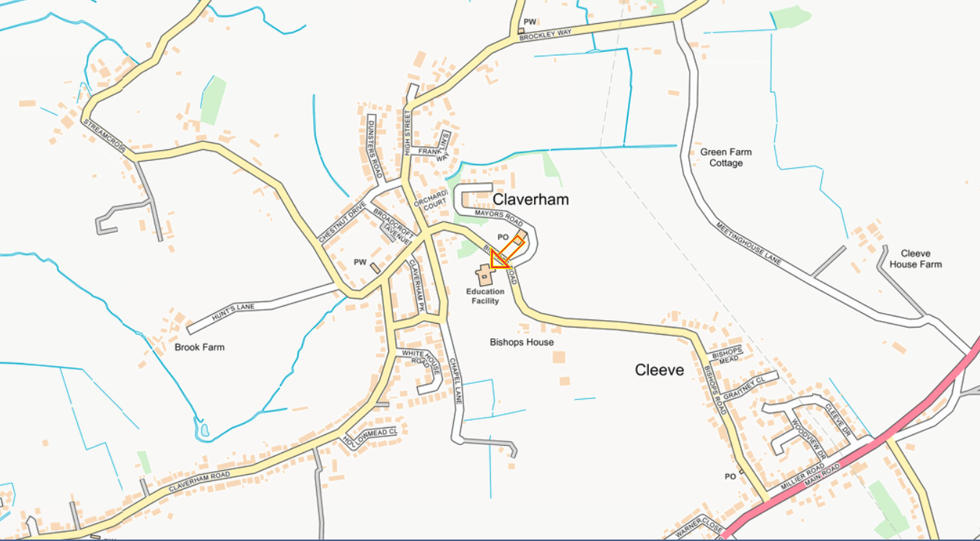
Can you find any places that you recognise?
Notes:
Map: www.streetmap.co.uk, accessed 1 June 2022

Slide 20
Activity 1
Explore the map of Claverham and see whether you can find any of the places that we have spoken about or that may be significant.
Can you find…?
Our school
St Barnabas Church
Bishops Farm
Claverham Court Farm
Village Hall
Friends Meeting House
Your house

Slide 21
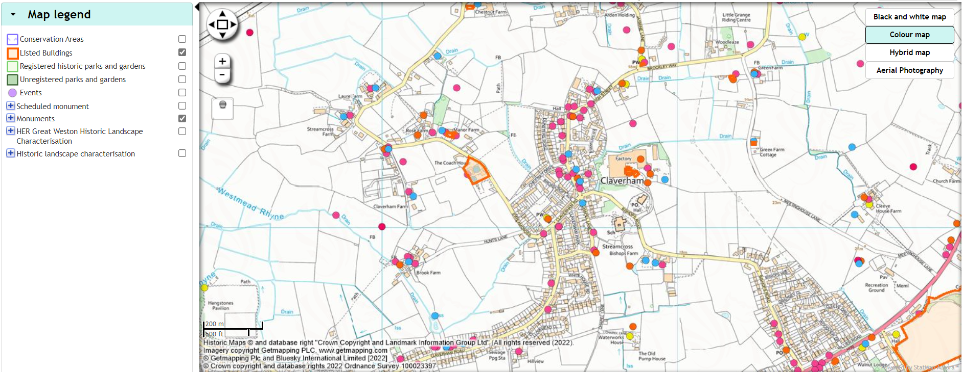
Exploring our historic environment
All around us are places that tell us about our past. This is known as our historic environment. We can use maps to find them.
Notes:
Map: http://map.n-somerset.gov.uk/her.html, accessed 12 April 2022
These are available for other areas through www.heritagegateway.org.uk

Slide 22

What is a listed building?
Some places are considered so significant that they are added to a special list.
Listed buildings are:
Special
Protected
Preserved (kept in good condition) for future generations
Notes:
Video: Historic England, www.youtube.com/watch?v=ZxLZ4uA_vUg

Slide 23
Remember our significant places criteria…
They are significant because they…
played an important role in people’s lives
were the location for a key event in the past
are a good example of a building from a particular time period
are linked with a significant individual (e.g. their home)
Role Event Example Linked
Not all significant places will be listed, but many of them are!
Many listed places are old but a place doesn’t have to be old to be significant (some places we use now may become significant in the future).

Slide 24
Plenary
The Claverham Meeting House is a Grade II* listed building, which means that it is considered of special interest and should be protected for future generations.
What do you think it is about this building that makes it significant and worth protecting for future generations?
Notes:
Image: Copyright © 2009, Claverham Meeting House Trust, all rights reserved, from www.claverhammeetinghouse.org.uk (permission to use all images held by the Meeting House Trust given by the Management Trust)

Slide 25
Enquiry question
Why is the Meeting House a significant place in the history of Claverham?

Slide 26
Enquiry overview
Lesson 1: What does it mean for a place to be significant?
Lesson 2: What places are significant in Claverham?
Lesson 3: Who used the Meeting House in the past and why was it significant to them?
Lesson 4 (visit to the Meeting House): What can the building tell us about the significance of the Meeting House to Claverham?
Lesson 5: How has the significance of the Meeting House changed over time?
Lesson 6 (outcome activity): How can we record and share the history of the Meeting House?

Slide 27
Lesson 3
Who used the Meeting House in the past and why was it significant to them?

Slide 28
Lesson 3 overview
Recap: What do we mean by significant?
Why was the Meeting House built?
Activity 1: Exploring images of the Meeting House
Who was Eliza Gregory?
Activity 2: Reading Eliza’s memories
Plenary

Slide 29
What do we mean by significant?
Remember our significant places criteria…
They are significant because they…
played an important role in people’s lives
were the location for a key event in the past
are a good example of a building from a particular time period
are linked with a significant individual (e.g. their home)
Role Event Example Linked

Slide 30
Why was the Meeting House built?
The Meeting House in Claverham was first built in 1673 on land given by Richard Dawson of Yatton to ‘the people called Quakers to meet together to worship the Lord their God and for some of their poor Friends to inhabit therein’.
In his will, he said that the land could be used by the Quakers for 2,000 years.
Notes:
Details of Richard Dawson’s will: www.claverhammeetinghouse.org.uk/history, accessed 21 March 2022

Slide 31
Land given for the Meeting house to be built
1673
Meeting House rebuilt and extended
1729
Now (2022)
Approx. 60 years
230 years
20–30 years
20–30 years
Your parents were born (1980s)
You were born (2016)
Your grandparents were born (1960s)

Slide 32
Quakers were people who believed in God but didn’t like the way that churches were run. They wanted to hold their own meetings instead of going to church.
In the beginning, it was against the law to hold meetings, and they were often broken up, with the Friends (as the Quakers call themselves) being ordered to leave and even having their belongings confiscated (including several cows!).

Slide 33
Claverham Meeting House provided a safe place for Friends in the area to meet together in worship, and the land that they were given also gave them a place to create a burial ground for Friends.
Without the Meeting House, Friends would not have been able to meet regularly in the area without risking arrest.
The original Meeting House was rebuilt in 1729 to make it bigger, and that is the building that still stands on the site today.

Slide 34
Activity 1
Explore the images of the Meeting House from different periods of time.
Can you look at clues in the images to try to put them in chronological order from oldest to most recent?
How significant does the Meeting House appear to be to the people of Claverham in each of the photos?

Slide 35
Who was Eliza Gregory?
Due to copyright restrictions we are unable to display this image. Please insert the picture from this link: https://www.npg.org.uk/collections/search/portrait/mw212818
Image: Gertie Millar as Prudence Pym from the Edwardian musical ‘The Quaker Girl’, by Rita Martin, published by Rotary Photographic Co Ltd, bromide postcard print 1910–1911, NPG x160534
© National Portrait Gallery, London
Notes:
Due to copyright restrictions we are unable to display the above image. Please insert the photo from this link: https://www.npg.org.uk/collections/search/portrait/mw212818
Image: Gertie Millar as Prudence Pym from the Edwardian musical ‘The Quaker Girl’, by Rita Martin, published by Rotary Photographic Co Ltd, bromide postcard print 1910–1911, NPG x160534
© National Portrait Gallery, London

Slide 36
Eliza Gregory was born in Claverham nearly 200 years ago, in 1832.
Land given for the Meeting house to be built
1673
Meeting House rebuilt and extended
1729
Now (2022)
160 years
130 years
20–30 years
20–30 years
Eliza Gregory was born
1832
Your parents were born (1980s)
You were born (2016)
Your grandparents were born (1960s)

Slide 37
Her parents were both from families that had lived in the area for a long time. Her father was Bishop Gregory (he always got teased for his first name) and her mother was born Sarah Eddington.
Her father was a grazier, who looked after animals on a farm.
Notes:
Details about Eliza: ‘Records and memories’ by Eliza (Gregory) Clark, courtesy of Claverham Meeting House Trust
A copy of Eliza’s birth record is available to access online but cannot be included here due to copyright restrictions

Slide 38
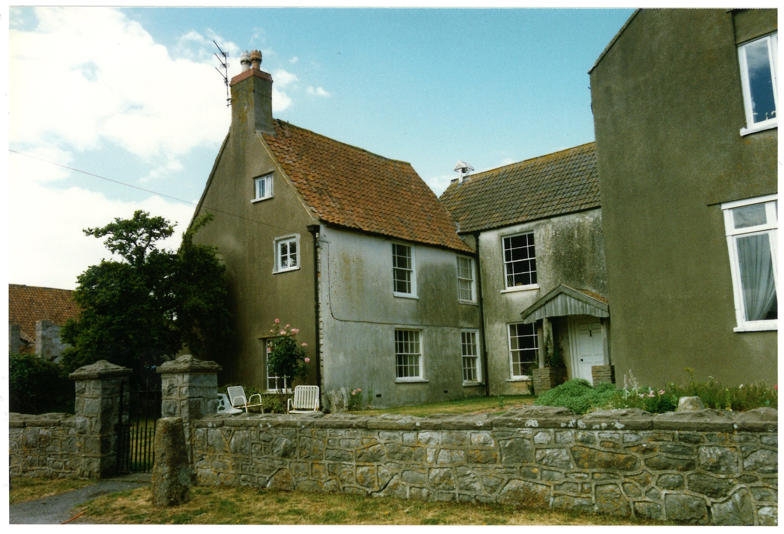
When she was born, her family were living in Claverham Court Farm. Can you remember finding this on the map of Claverham?
She was the youngest of 12 children and her oldest sister was 21 years older than her. She described it as being like ‘having four mothers to oversee me’.
Notes:
Image: Claverham Court Farmhouse from Somerset Archives via South West Heritage Trust (Ref A/DIQ/76/230 )
Quote: ‘Records and memories’ by Eliza (Gregory) Clark, courtesy of Claverham Meeting House Trust

Slide 39
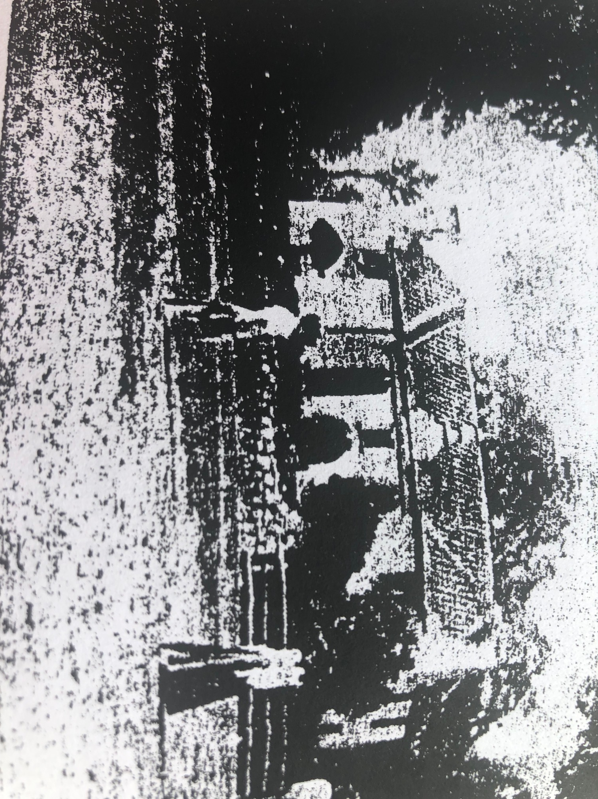
Her family attended bi-weekly (twice a week) meetings at the Meeting House in Claverham.
A meeting was a bit like an assembly. They would get together and share their ideas and opinions about lots of topics. No one led the meeting but they would all sit in silence until someone felt that they had something they wanted to say.
Notes:
Image: front of the Meeting House from ‘Records and memories’ by Eliza (Gregory) Clark, courtesy of Claverham Meeting House Trust

Slide 40
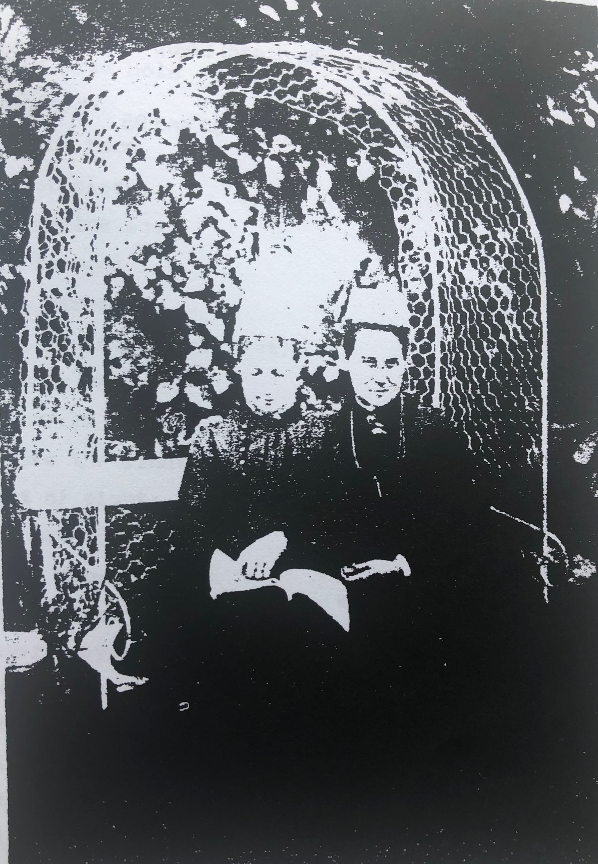
When she was an old lady, she wrote down her memories of childhood so that her family and others would know what life was like in Claverham in the past.
Notes:
Image: Eliza Clark with her relative, Isabella Sharp, from ‘Records and memories’ by Eliza (Gregory) Clark, courtesy of Claverham Meeting House Trust

Slide 41
Activity 2
Listen to some of Eliza’s memories of visiting the Meeting House to find out how significant the building was in her early life.
Can you find out…
How she travelled to the Meeting House?
How long the meetings lasted for?
Who she saw at the Meeting House?
What she thought about the building?
Challenge: How significant was the Meeting House at the time when Eliza was living in Claverham with her family?

Slide 42
Plenary
Do you think that the building’s significance always stayed the same, or were there some times when it was more significant than others?

Slide 43
Enquiry question
Why is the Meeting House a significant place in the history of Claverham?

Slide 44
Enquiry overview
Lesson 1: What does it mean for a place to be significant?
Lesson 2: What places are significant in Claverham?
Lesson 3: Who used the Meeting House in the past and why was it significant to them?
Lesson 4 (visit to the Meeting House): What can the building tell us about the significance of the Meeting House to Claverham?
Lesson 5: How has the significance of the Meeting House changed over time?
Lesson 6 (outcome activity): How can we record and share the history of the Meeting House?

Slide 45
Lesson 4
What can the building tell us about the significance of the Meeting House to Claverham?
(Visit to the Meeting House)

Slide 46
Lesson 4 overview
What do we already know about the building?
What do we expect to see?
Recap: What makes a place significant?
What skills will we need to use?
Activity 1: Exploring the building and grounds
Activity 2: Exploring the building's Georgian features
Plenary

Slide 47
What do we already know about the building?
Notes:
Image: Copyright © 2009, Claverham Meeting House Trust, all rights reserved, from www.claverhammeetinghouse.org.uk (permission to use all images held by the Meeting House Trust given by the Management Trust)

Slide 48
What do you expect to see?
Notes:
Image: Copyright © 2009, Claverham Meeting House Trust, all rights reserved, from www.claverhammeetinghouse.org.uk (permission to use all images held by the Meeting House Trust given by the Management Trust)

Slide 49
What makes a place significant?
Remember our significant places criteria:
They are significant because they…
played an important role in people’s lives
were the location for a key event in the past
are a good example of a building from a particular time period
are linked with a significant individual (e.g. their home)
Role Event Example Linked

Slide 50




Fieldwork skills
When we visit the Meeting House, it is important that we think like historians and collect as much information as we can.
We will use the following skills:
Observing and describing
Creating a fieldwork sketch
Enquiry skills
Questioning
Notes:
Fieldwork skills: Dixon, L. and Hales, A. (2014) Bringing History Alive Through Local People and Places: a guide for primary school teachers, London and New York: Routledge, p. 42
Images: Microsoft Office icons

Slide 51
1. Observing and describing
  What can you see?
  What does it look like?
  What do you notice?
  Can you spot anything familiar or surprising?
Notes:
Image: Microsoft Office icons

Slide 52
2. Creating a fieldwork sketch
  What are some key details of the building?
  What features make it a good example of a building of its age?
  What features make it unique?
Notes:
Image: Microsoft Office icons

Slide 53
3. Enquiry skills
  What clues tell you how the Meeting House has changed?
  What might be missing that you would expect to see?
  What can you discover about how significant it was in the past?
Notes:
Image: Microsoft Office icons

Slide 54
4. Questioning
  How is the Meeting House used today?
  How significant is the Meeting House today?
  What does it tell us about the history of Claverham?
  What else do you want to find out?
Notes:
Image: Microsoft Office icons

Slide 55
Remember to think about what makes the Meeting House a significant place…
What role does the building play in people’s lives now and in the past?
Did any important events happen there?
Is it a good example of a building for its time?
Is there a link with anyone significant?

Slide 56
Enquiry question
Why is the Meeting House a significant place in the history of Claverham?

Slide 57
Activity 1
Activity 2
Tour of the Meeting House and the burial ground, including what it would be like to attend a meeting in Eliza’s time (1840s)
Explore the key features of the front of the Meeting House and create some fieldwork sketches

Slide 58
Plenary
What part of the building did you find the most interesting and why?
How does the building meet our significant places criteria?
What else would you like to find out?

Slide 59
Enquiry overview
Lesson 1: What does it mean for a place to be significant?
Lesson 2: What places are significant in Claverham?
Lesson 3: Who used the Meeting House in the past and why was it significant to them?
Lesson 4 (visit to the Meeting House): What can the building tell us about the significance of the Meeting House to Claverham?
Lesson 5: How has the significance of the Meeting House changed over time?
Lesson 6 (outcome activity): How can we record and share the history of the Meeting House?

Slide 60
Lesson 5
How has the significance of the Meeting House changed over time?

Slide 61
Lesson 5 overview
What did we discover from our visit to the building?
What makes the Meeting House significant? The building
What makes the Meeting House significant? Role in people’s lives
Activity 1: Tracking the significance of the Meeting House
Plenary

Slide 62
What do you remember seeing on your visit to the building?
Notes:
Image: Copyright © 2009, Claverham Meeting House Trust, all rights reserved, from www.claverhammeetinghouse.org.uk (permission to use all images held by the Meeting House Trust given by the Management Trust)

Slide 63
What makes the Meeting House significant?
Remember our significant places criteria:
They are significant because they…
played an important role in people’s lives
were the location for a key event in the past
are a good example of a building from a particular time period
are linked with a significant individual (e.g. their home)
Role Event Example Linked

Slide 64
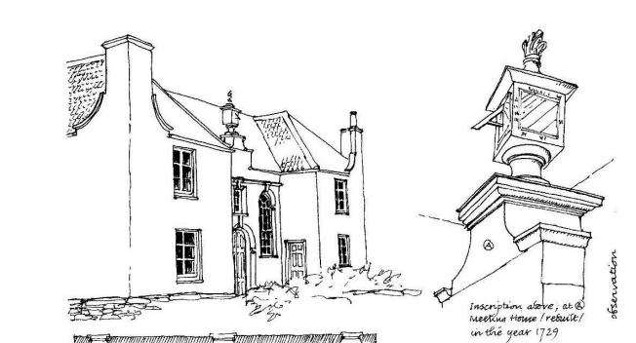
What makes the Meeting House significant?
The Meeting House is a significant building because it is a good example of a Georgian building (this was the name given to buildings built while King George I was on the throne). It is symmetrical with large windows. Many meeting houses built at the same time were much smaller.
Notes:
Image: Quaker Meeting Houses Heritage Project, https://heritage.quaker.org.uk, accessed 21 March 2022

Slide 65
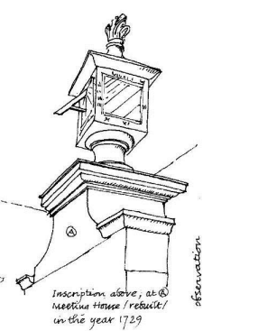
What makes the Meeting House significant?
The sundial on the top of the building is unusual because the time it shows is always late. That is because it is set to Bristol time, which was different from the time in London and other places in England.
We only used the same time once railways were built and people could travel more quickly around the country, which meant that we needed the time to be the same throughout England.
Notes:
Image: Quaker Meeting Houses Heritage Project, https://heritage.quaker.org.uk, accessed 21 March 2022

Slide 66
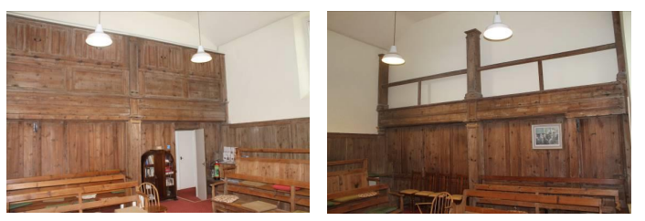
What does the inside of the building tell us about its significance?
The inside of the building still shows where there used to be two galleries. These provided extra space for people to sit for meetings. This tells us that lots more people used to attend the meetings than there is room for now.
One of the upstairs galleries was used by the female members to hold separate business meetings. Very few meeting houses in the country have this separate space for women.
Notes:
Images: Quaker Meeting Houses Heritage Project, https://heritage.quaker.org.uk, accessed 21 March 2022

Slide 67
What makes the Meeting House significant?
Remember our significant places criteria:
They are significant because they…
played an important role in people’s lives
were the location for a key event in the past
are a good example of a building from a particular time period
are linked with a significant individual (e.g. their home)
Role Event Example Linked

Slide 68
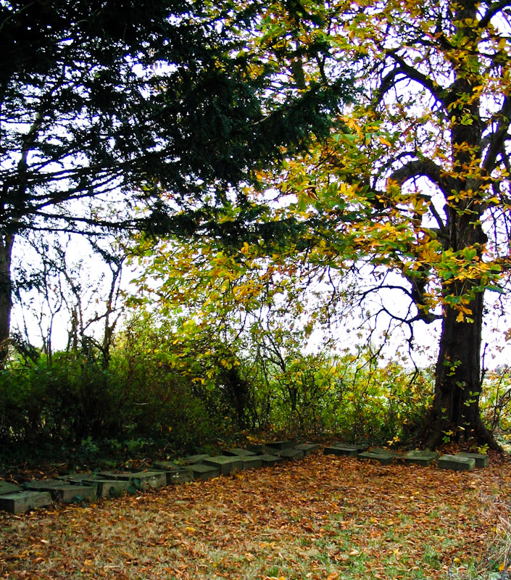
What makes the Meeting House significant?
For about 160 years, the Meeting House was a significant building for many families living in Claverham and the surrounding area.
Families like the Gregorys would visit for weekly meetings, as well as using the building for significant family events such as weddings and burials.
Meeting House burial ground
Notes:
Image: www.claverhammeetinghouse.org.uk, accessed 21 March 2022

Slide 69
What does the building being rebuilt and extended tell us about how popular it was in 1729?

Slide 70
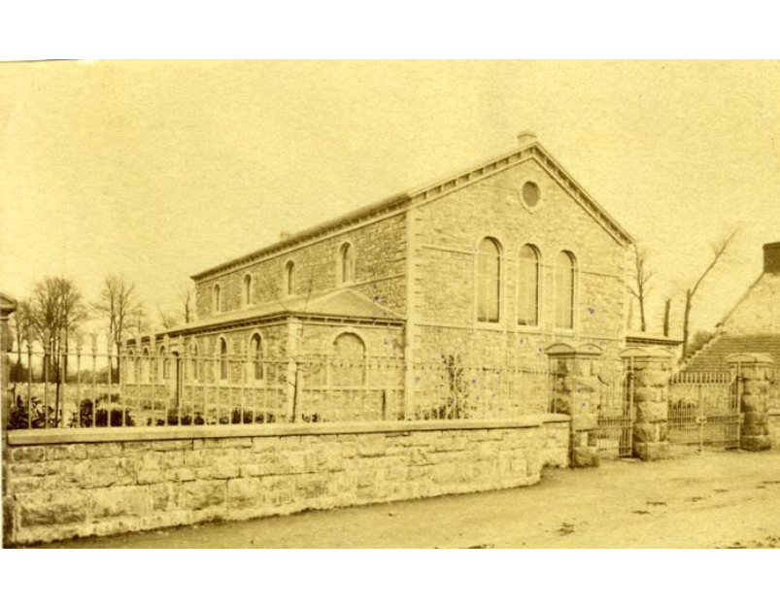
In the 1841, the railway came to nearby Yatton. More people began to travel by train and many more people lived in Yatton compared to Claverham. They wanted their meeting house to be closer to their homes and to the station. A new meeting house was built in Yatton in 1868.
What impact do you think the new meeting house being opened in Yatton in 1868 had on Claverham Meeting House?
Yatton Meeting House opened in 1868 and closed in 1912. It is now the site of Yatton Library.
Notes:
Image: Yatton Meeting House, via TriCollege Libraries Digital Collections, https://digitalcollections.tricolib.brynmawr.edu/object/hc144061, accessed 21 March 2022

Slide 71
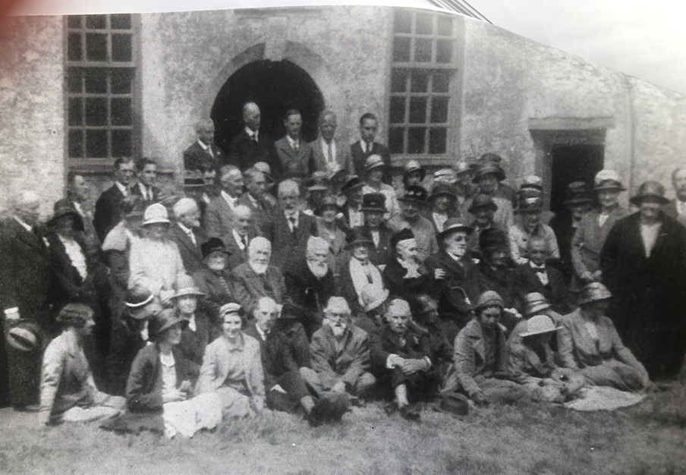
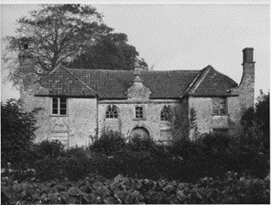
By 1872, the Meeting House was no longer being regularly used.
It was used for the annual area meeting in 1932, but there were no regular meetings.
By the 1940s, the land was overgrown and the building needed lots of money to repair it.
Notes:
Images: courtesy of Claverham Meeting House Trust

Slide 72
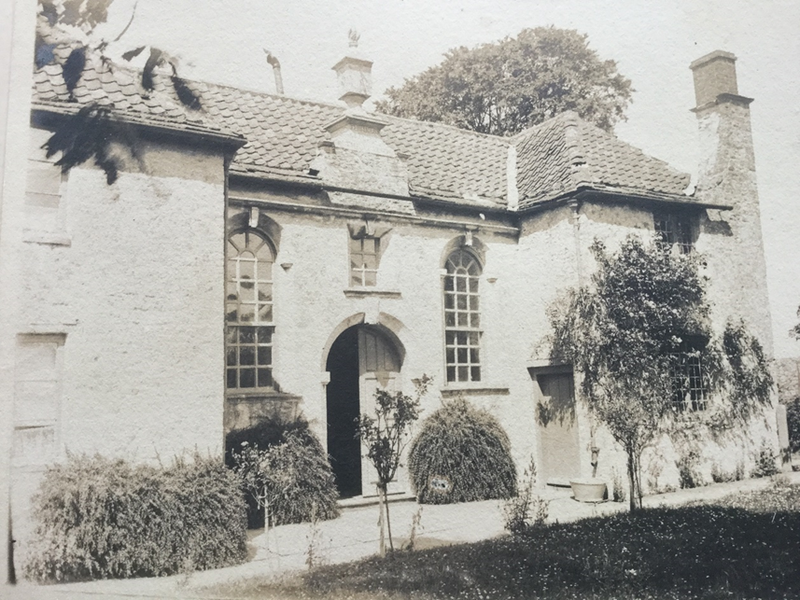
In 1952, the Meeting House became a listed building. Thanks to a local Quaker family who had made a lot of money through making and selling shoes (the Clark family), the Meeting House was repaired and the Meeting House Trust was set up to look after the building in the future.
Notes:
Image: courtesy of Claverham Meeting House Trust

Slide 73
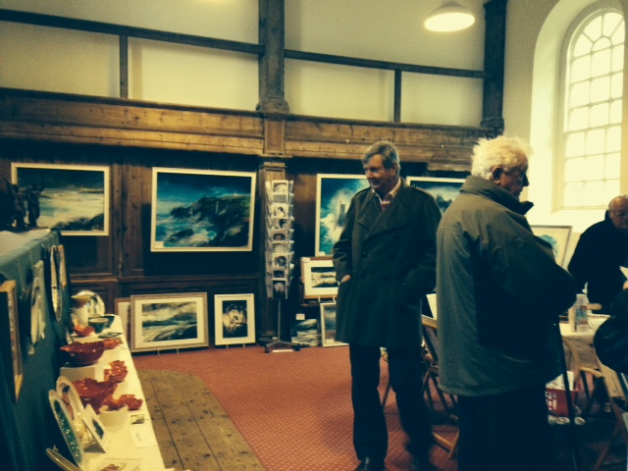
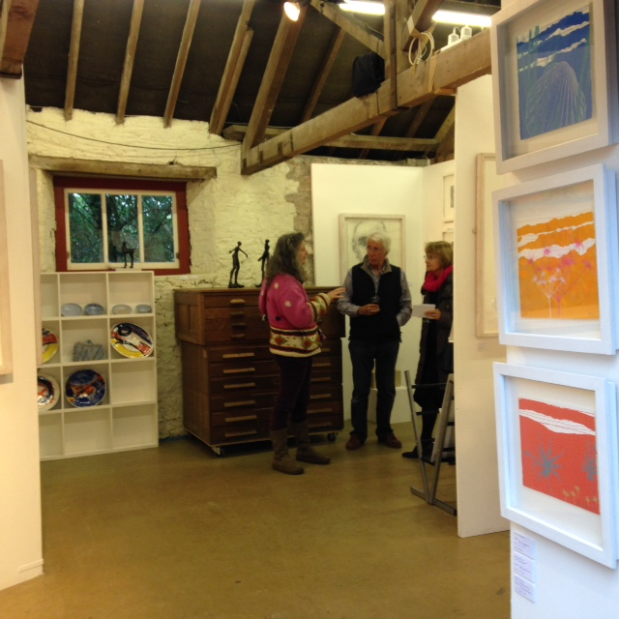
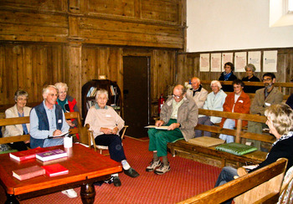
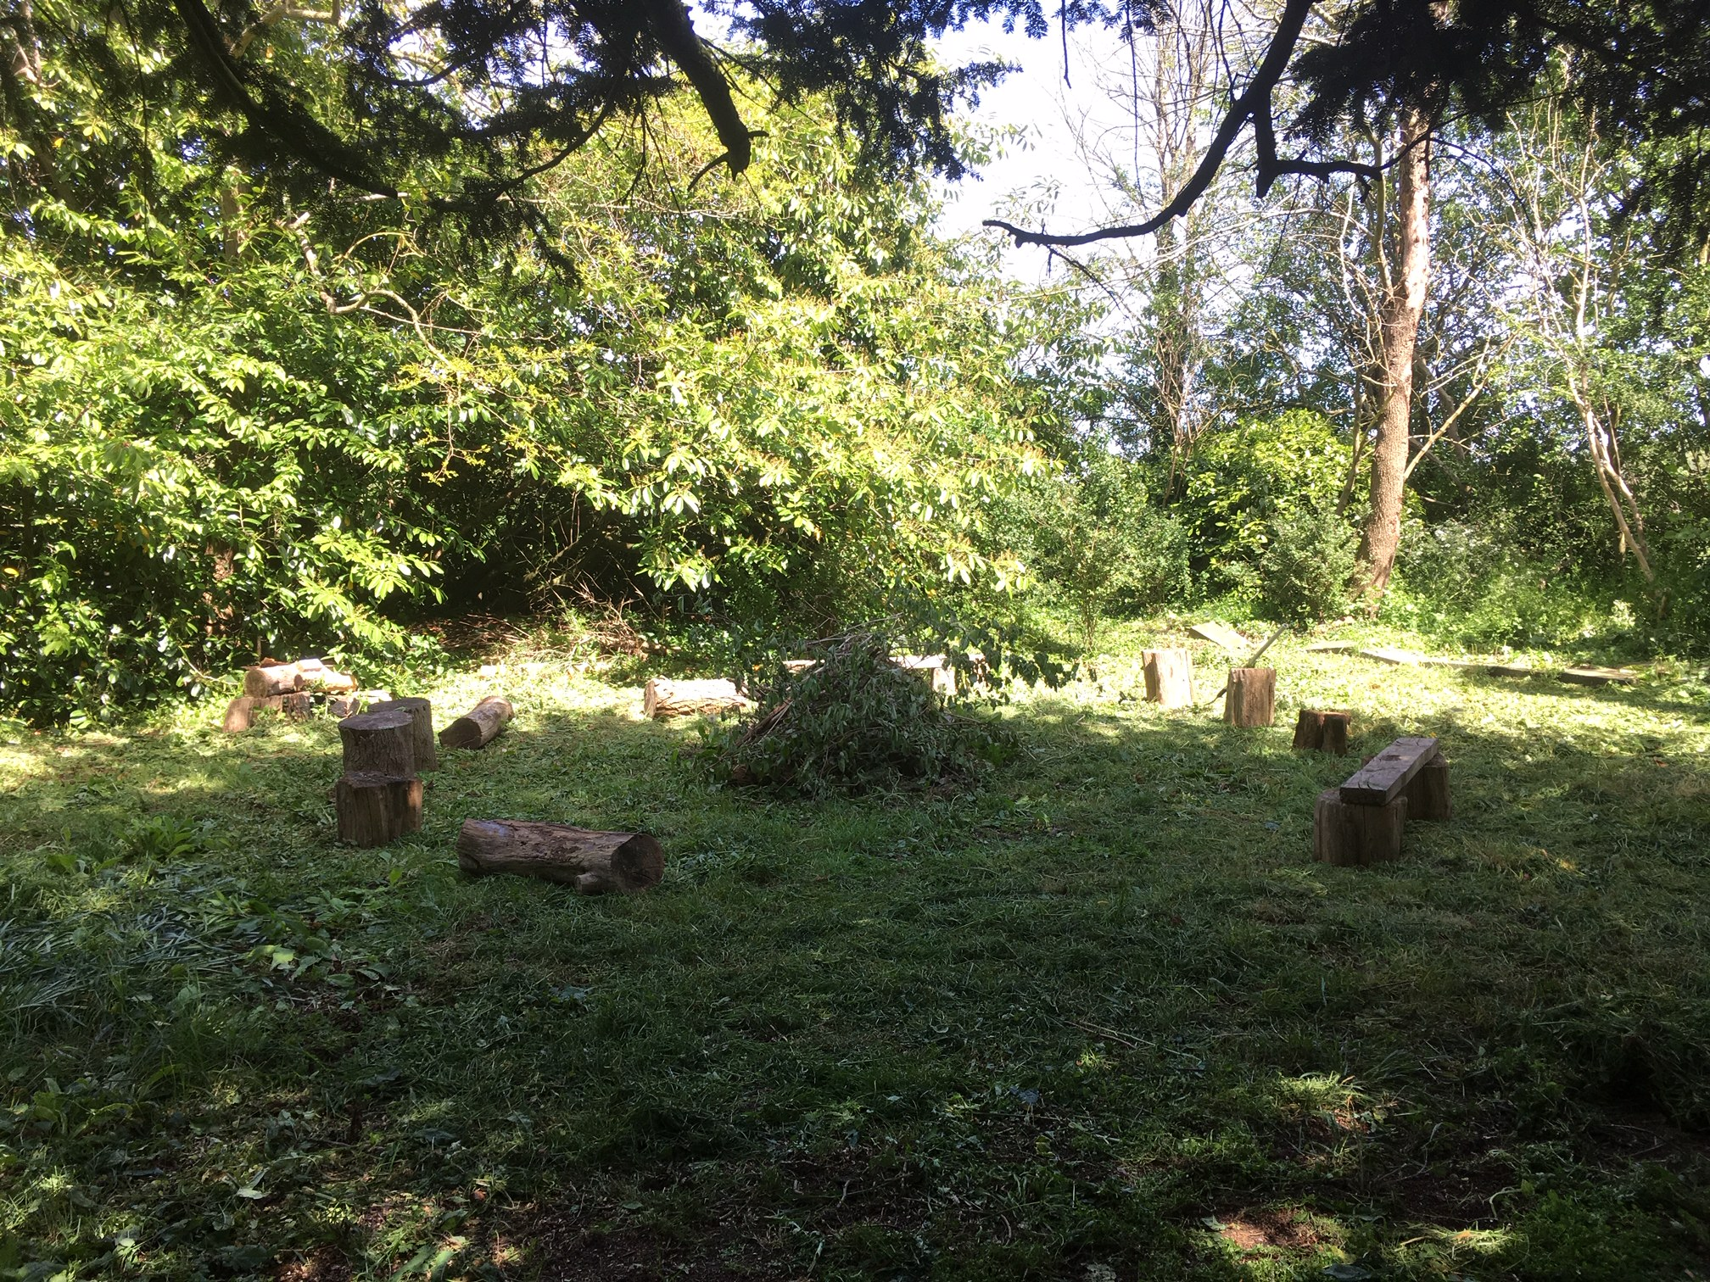
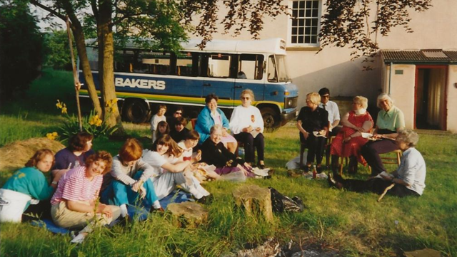
What is the Meeting House used for now?
Notes:
Images: courtesy of Tom Leimdorfer, Claverham Meeting House Trust

Slide 74
Activity 1
Read through the fact cards and colour in the box below each one to show how significant you think the Meeting House was during that time.
Not very significant
Fairly significant
Very significant

Slide 75
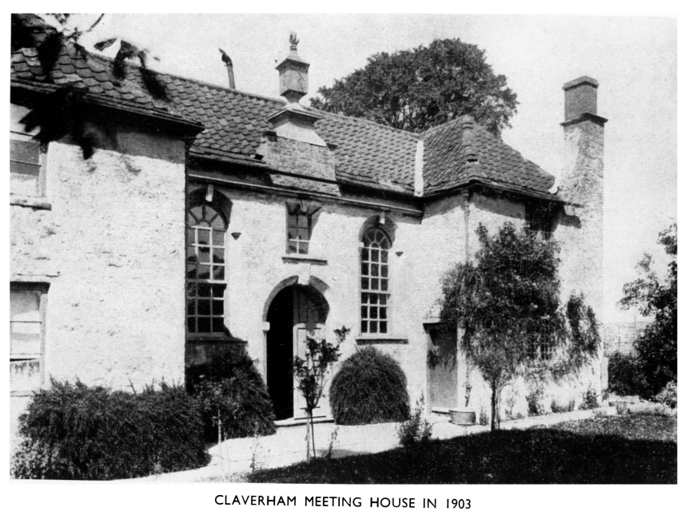
Plenary
Since it was built, the Meeting House has been saved and rebuilt or repaired several times. What does this tell us about how people feel about the building?
Notes:
Image: The Journal of the Friend’s Historical Society, spring 1953

Slide 76
Enquiry question
Why is the Meeting House a significant place in the history of Claverham?

Slide 77
Enquiry overview
Lesson 1: What does it mean for a place to be significant?
Lesson 2: What places are significant in Claverham?
Lesson 3: Who used the Meeting House in the past and why was it significant to them?
Lesson 4 (visit to the Meeting House): What can the building tell us about the significance of the Meeting House to Claverham?
Lesson 5: How has the significance of the Meeting House changed over time?
Lesson 6 (outcome activity): How can we record and share the history of the Meeting House?

Slide 78
Lesson 6
How can we record and share the history of the Meeting House?

Slide 79
Lesson 6 overview
Final outcome
What are the key moments in the life of the Meeting House?
How can we represent these moments?
Activity 1: Creating our 3D timeline display
Activity 2: Tracking the significance of the Meeting House
Plenary

Slide 80
Final outcome
To share with others what we have learnt, we will work together to create a 3D timeline showing the history of the Meeting House.
We will then share this timeline with our school community and the people who help to look after the Meeting House.

Slide 81
Think about the work that we have done and what you have learnt about the Meeting House. In pairs/small groups, can you come up with three to five key moments in the life of the Meeting House?
What do you think are the key moments in the life of the Meeting House?

Slide 82
What are the key moments in the life of the Meeting House?
The land is given to build the Meeting House.
The Meeting House is rebuilt and extended.
Lots of families visit the Meeting House regularly.
The railway comes to Yatton and a new meeting house is built.
The Meeting House is abandoned and becomes overgrown.
It becomes a listed building and is repaired.
Regular meetings start again.

Slide 83
How could we represent these moments on our 3D timeline?
We will need to build a model to represent each moment in the Meeting House’s history to go on our timeline.
Example:
To show the railway coming to Yatton, which led to the Meeting House becoming less popular, you could make a model of a steam train.

Slide 84
Activity 1
In groups, you will each be given one of the significant moments to represent on our timeline. You can make a model using the resources provided, but it must be clear what moment your model is showing.

Slide 85
Activity 2
We will now colour-code each model to show how significant the Meeting House was to Claverham at each point.
Not very significant
Fairly significant
Very significant

Slide 86
Plenary
What do you think might impact the significance of the Meeting House in the future?
Remember that the Quakers were given the land for 2,000 years and they have only used it for 350 years – there’s a lot of time left!

